Slide 1
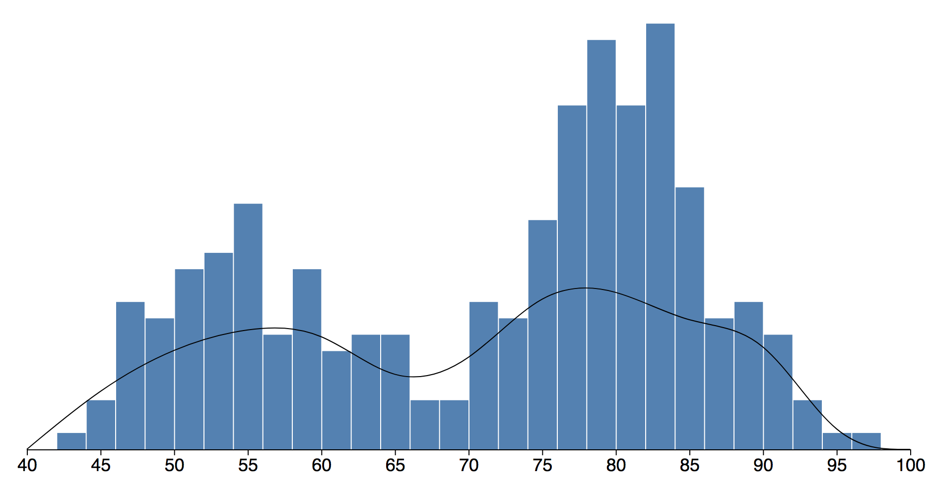
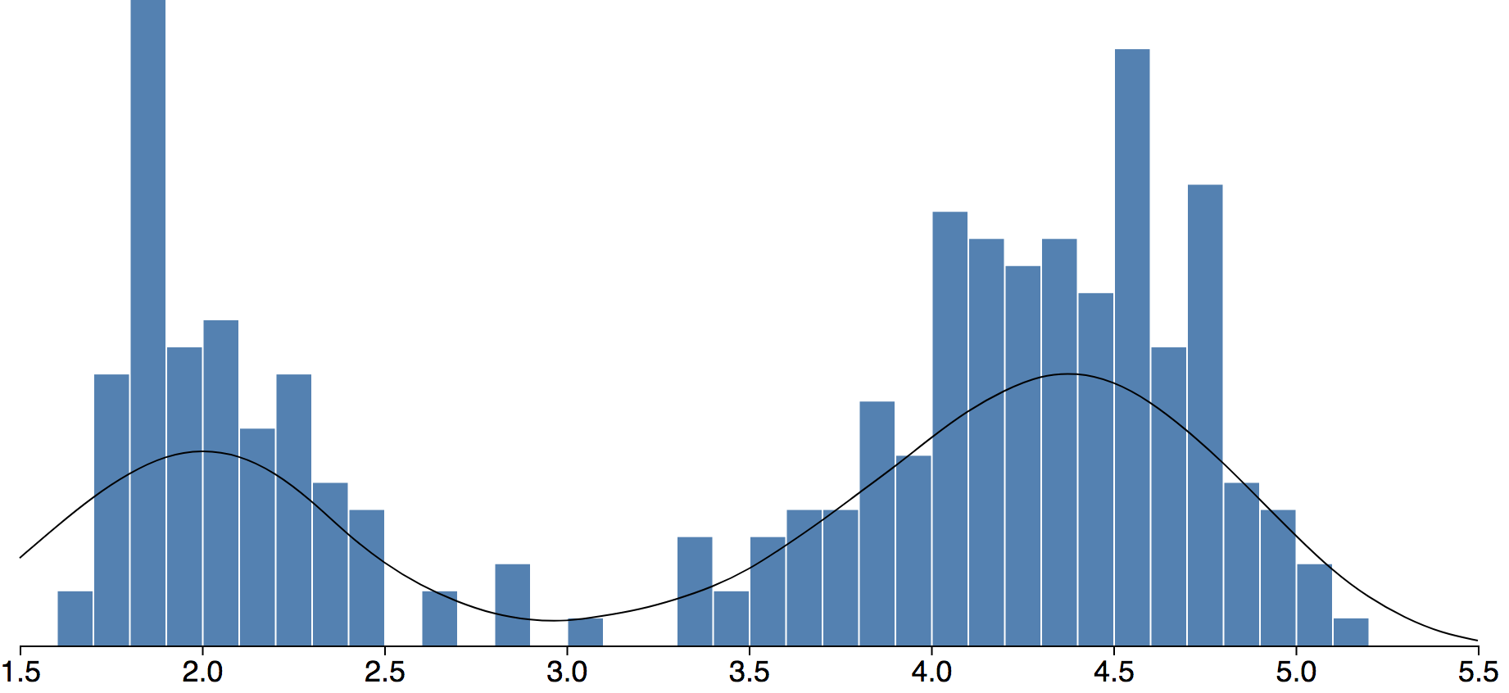
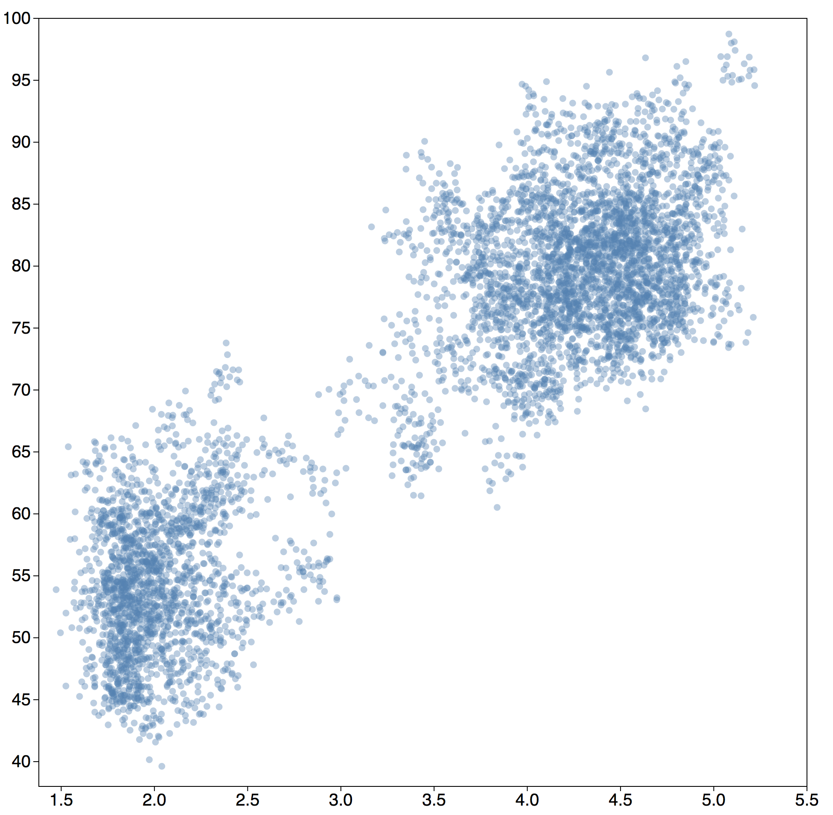
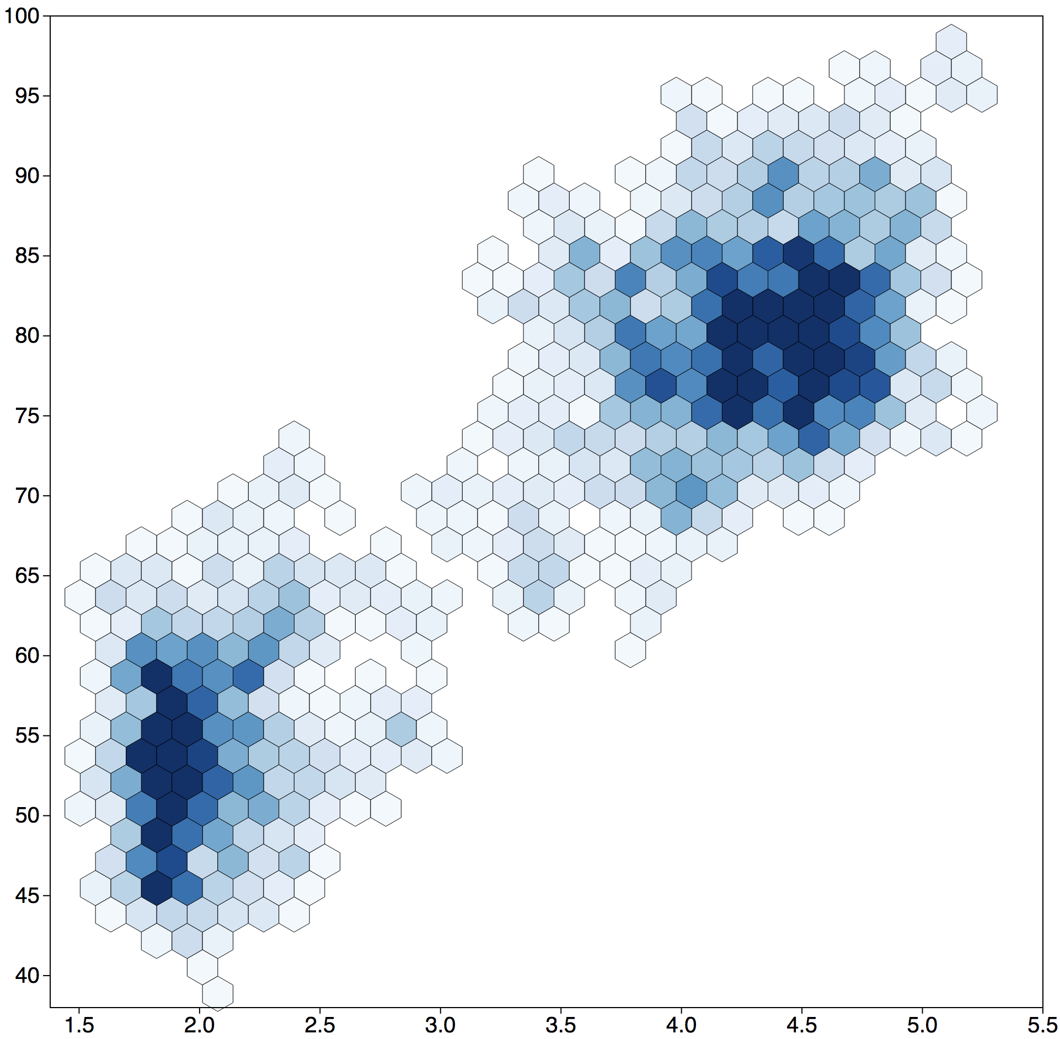
Waiting time (in minutes)
Eruption time (in minutes)
Waiting time
Waiting time
Eruption time
Eruption time

Slide 2
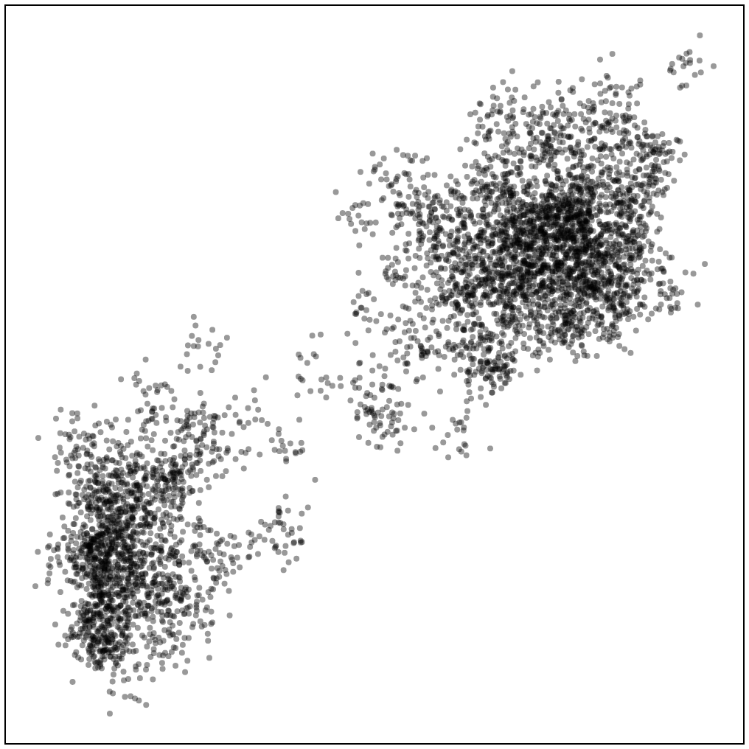
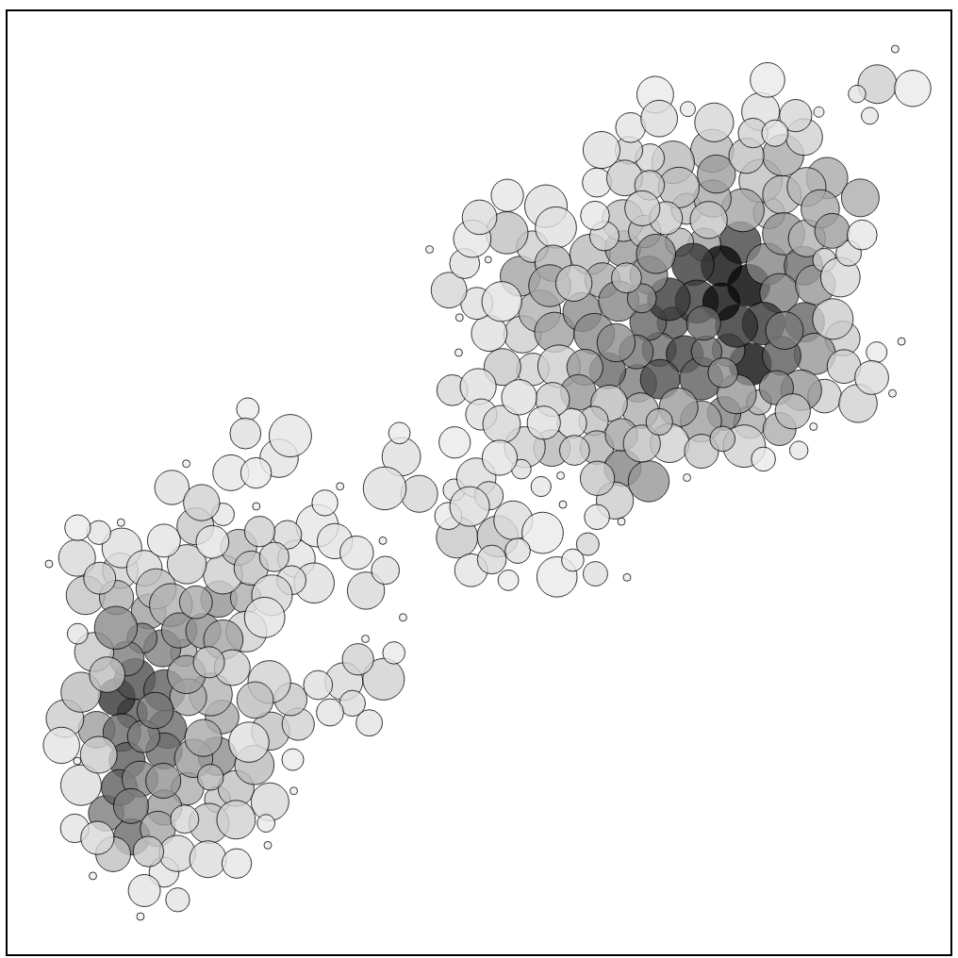
Waiting time
Waiting time
Eruption time
Eruption time

Slide 3
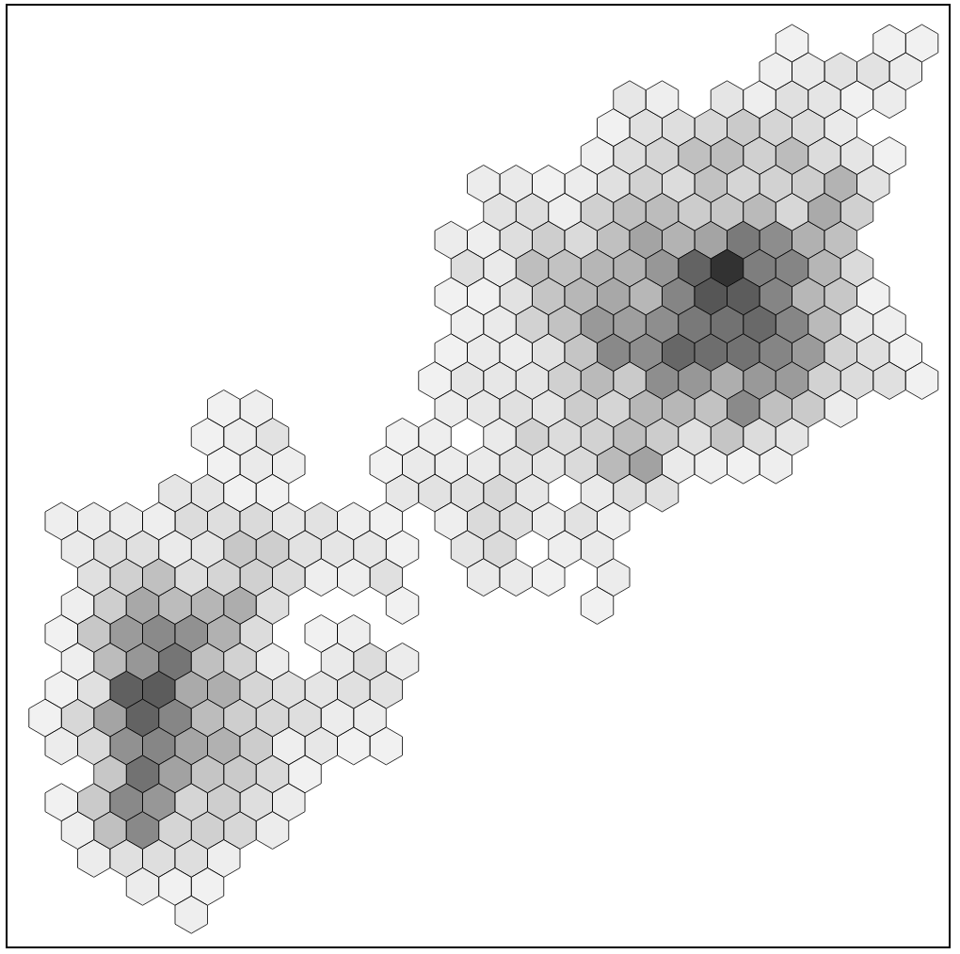
Original data
Hexagon Binning
Leader Binning
Waiting time
Waiting time
Waiting time
Eruption duration
Eruption duration
Eruption duration
(a)
(b)
(c)

Slide 4
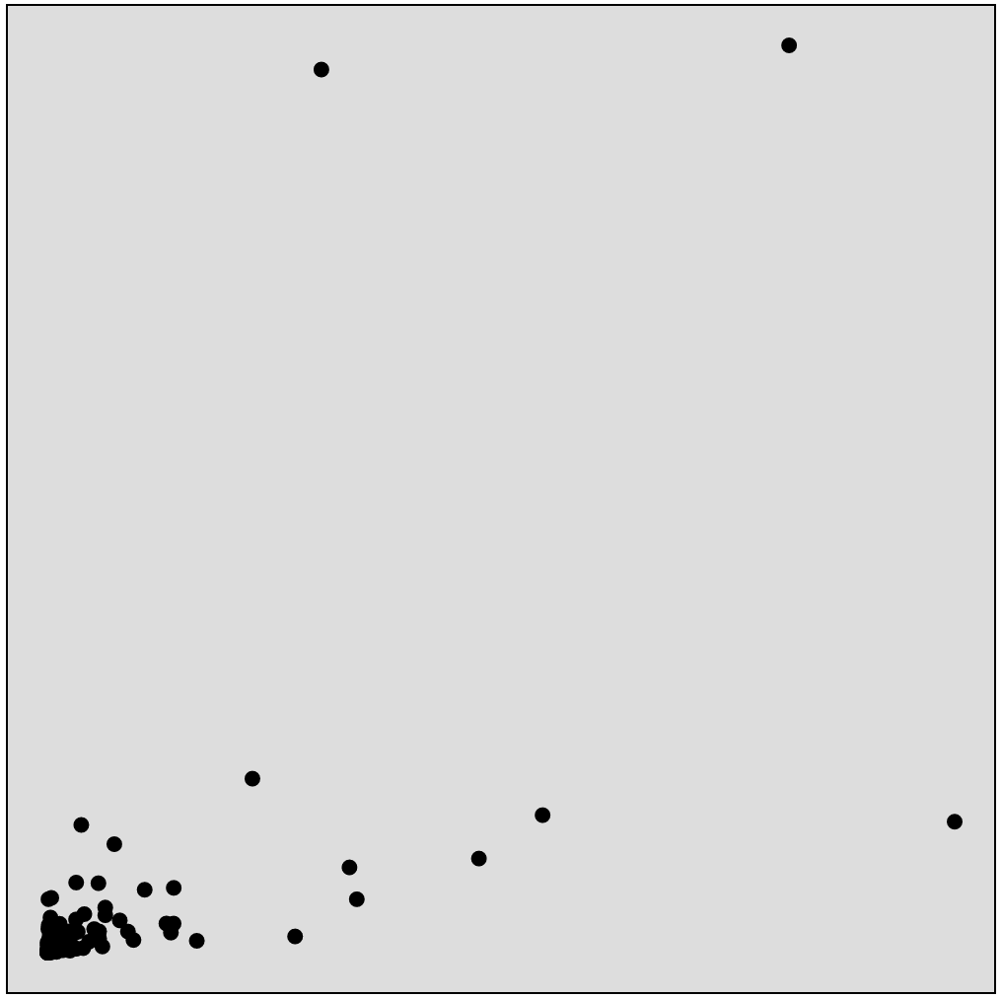
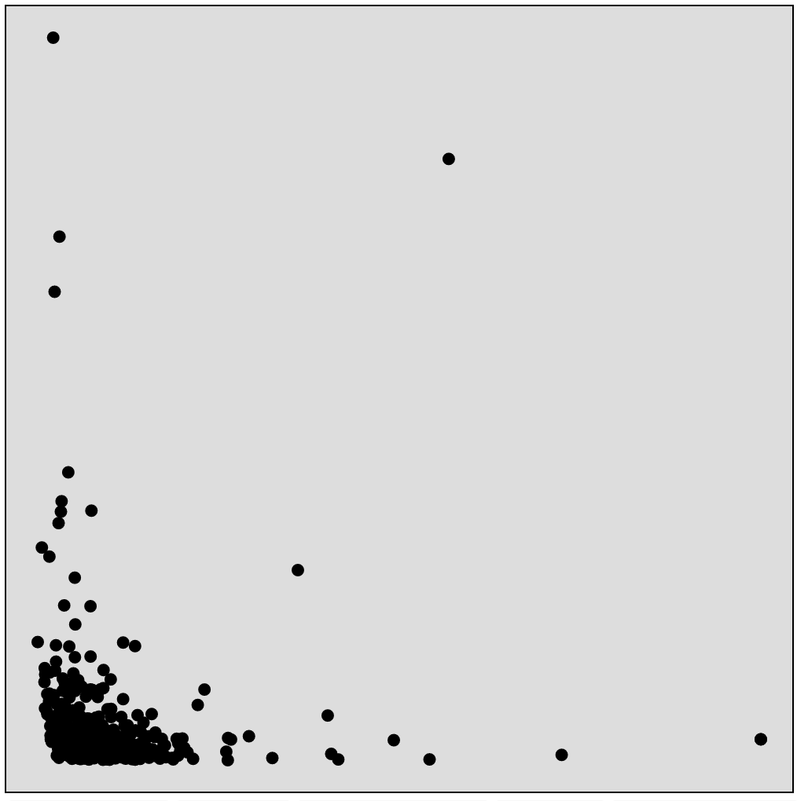
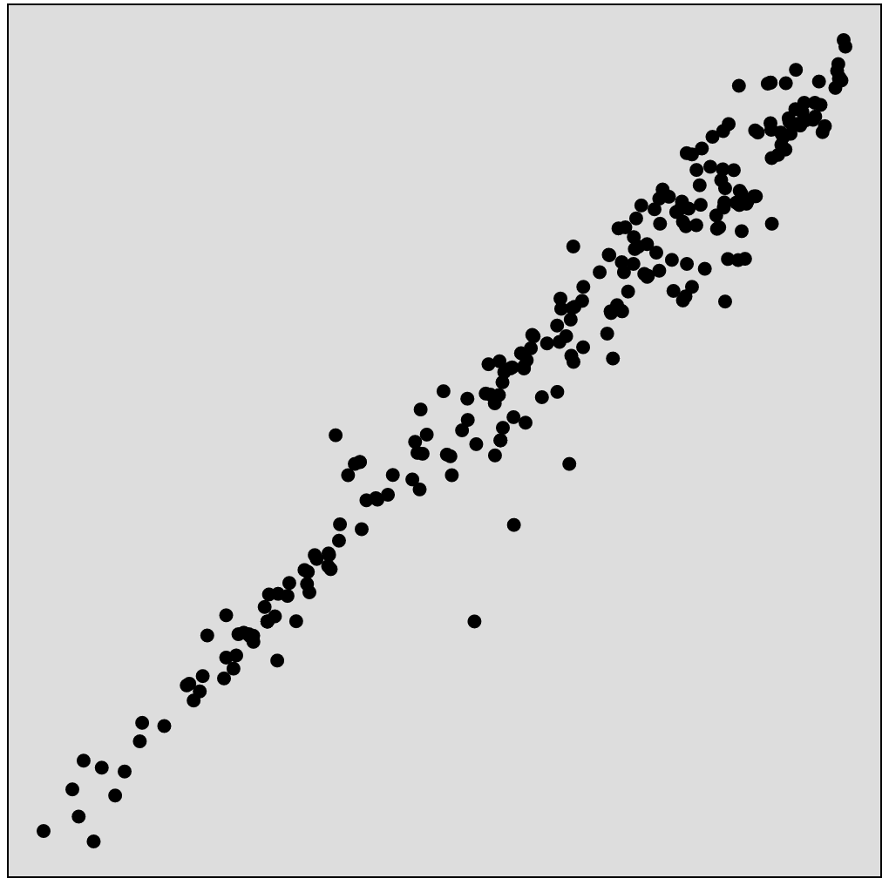



International debt in 2017
NY stock exchange on Jan 2011
Life expectancy in 1982
China
BAC
India
AAPL
Population
Volume
Male
NFLX
Irag
El Salvador
Iran
Pakistan
PCLN
GOOG
Debt
Price
Female
(a)
(b)
(c)
Facts
Pic0:
International debt (india) -> Debt vs. Population (Year 2017)
Pic 1
New York stock exchange price vs. volume (Jan 2011)
BAC: 14.3 vs. 232571115
AAPL: 338.38 vs. 1355
Pic 2
Life expectancy 1982
Life expectancy at birth (years), female vs. male

